Slide 1




Project 3
HEALTH
Predictive Analysis
PRESENTED BY:

Slide 2

01.
Introduction
Research Objective
Dataset Overview
Feature Visualization
Table of
Contents
02.
Predictive Modeling
Classifier Models
03.
Conclusion
Results
Recommendations
2

Slide 3


01.
Introduction
Let’s begin by looking at the research objective, preview the dataset provided and observe key features for predictive modeling.
3

Slide 4


01.
Introduction
This presentation forms part of my final Heart Disease Prediction Model project, showcasing my data science skills within my portfolio.
Successfully completed as part of the Xaltius Data Science Course Internship, combining hands-on learning with real-world applications.
I tested 4 algorithms to find the most accurate model. Logistic Regression performed the best with an accuracy of 78.47%, while Decision Tree lagged with an accuracy of 64.58%.
The project encompasses every step of the data science process — from defining the problem to developing and evaluating predictive models.
A practical, data-driven approach to tackling real-world challenges in the health sector!
4

Slide 5


Problem Statement
Objective
Heart disease is a leading cause of mortality worldwide.
Early detection and accurate prediction of heart disease can significantly improve patient outcomes by enabling timely intervention and preventive measures.
To develop a machine learning model that can effectively predict the presence or absence of heart disease based on various medical and lifestyle factors.
5

Slide 6
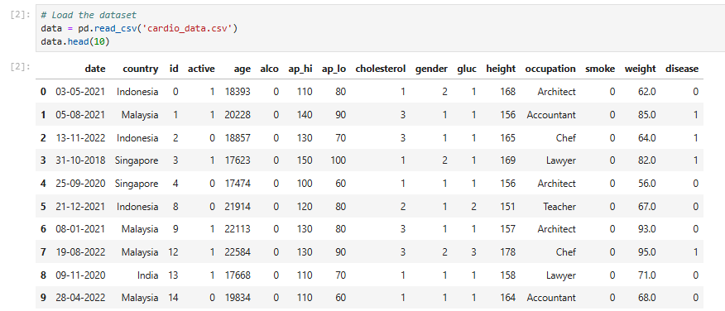
The Dataset – Quick Overview
The dataset provided for this project is a subset of data from Parkway Pantai to understand the
influence of various factors on the heart disease.
Data size: 70 000 rows and 16 columns
Gender column: Re-encode from 2 and 1 to 1 and 0 for Female and Male respectively.
Target variable: Absence of heart disease (0) and presence of heart disease.
Age column: Age displayed in days not years
6

Slide 7
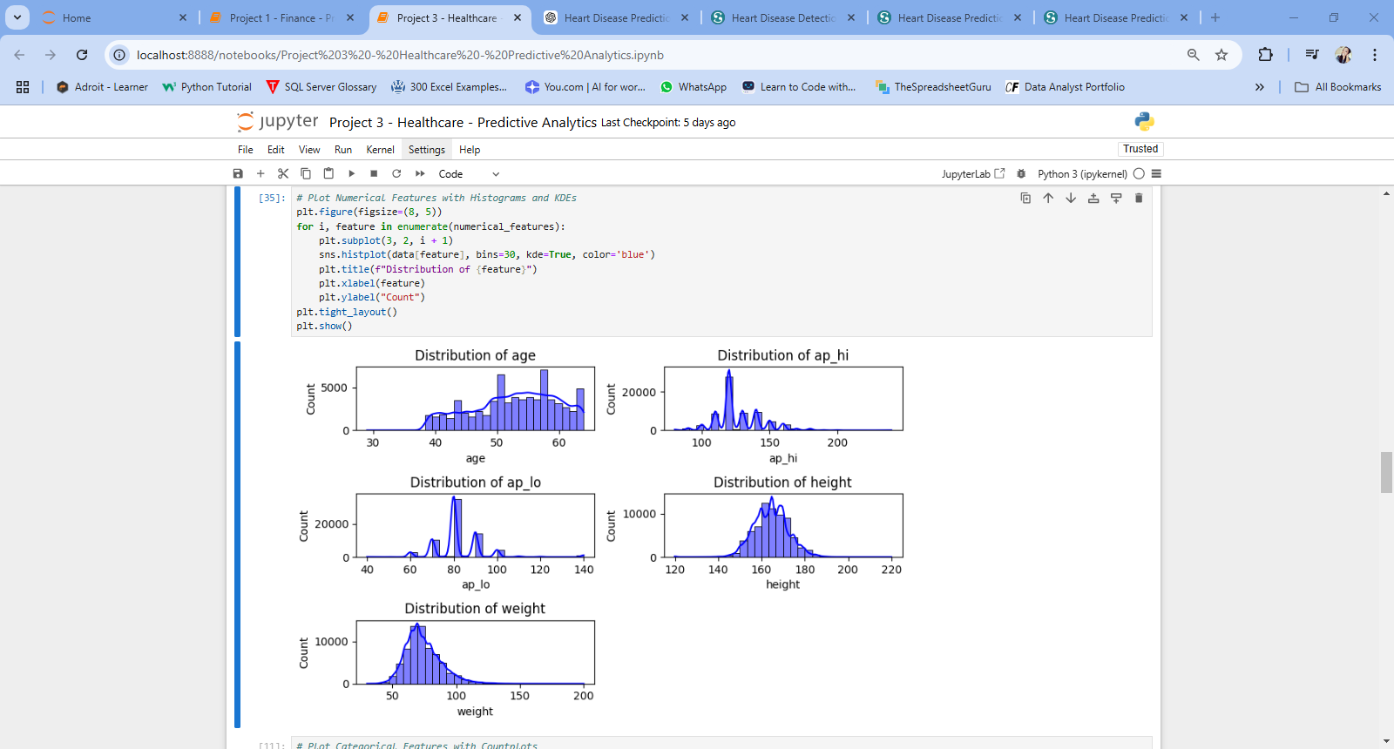
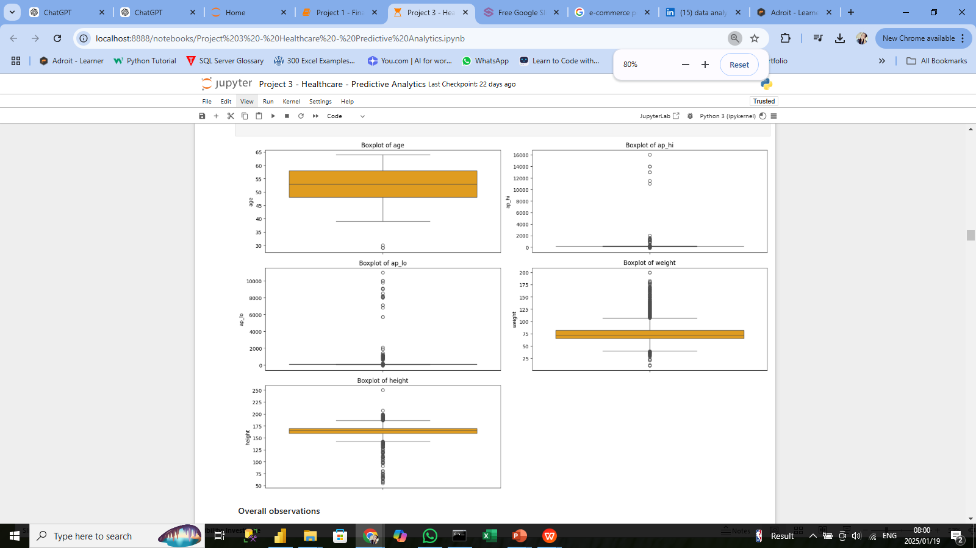
Distribution of Numeric Features
Clean Variables
Age, weight, and height distributions appear cleaner and can directly contribute to further analysis.
They are relatively well-distributed with minimal outliers.
Outliers
Both ap_hi and ap_lo have numerous extreme outliers.
This suggests data quality issues or incorrect entries that require cleaning.
7

Slide 8
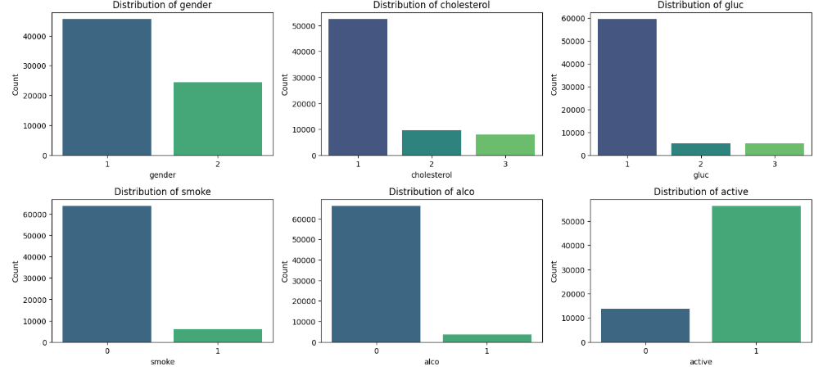
Distribution of Categorical Features
The dataset shows clear imbalances in categorical variables, with certain behaviors (e.g., smoking, drinking) and conditions (e.g., high glucose or cholesterol) being relatively uncommon.
The gender imbalance when interpreting findings may influence health trends.
8

Slide 9

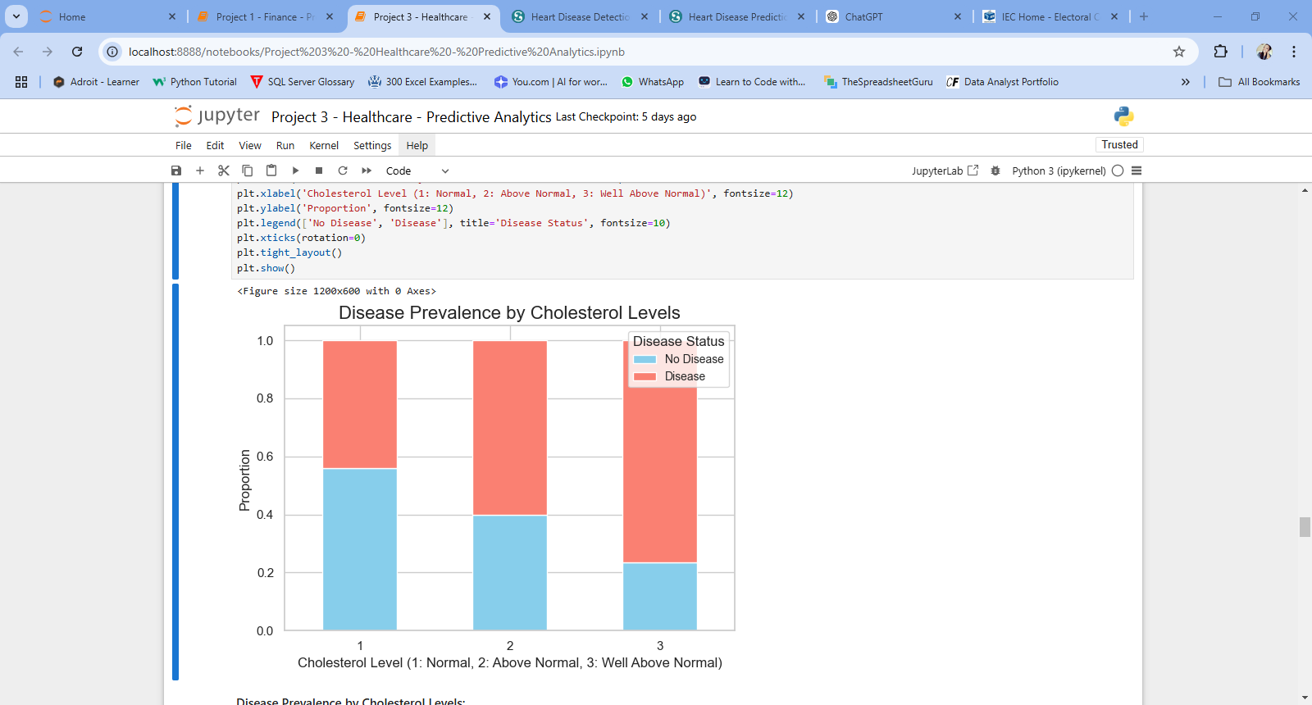
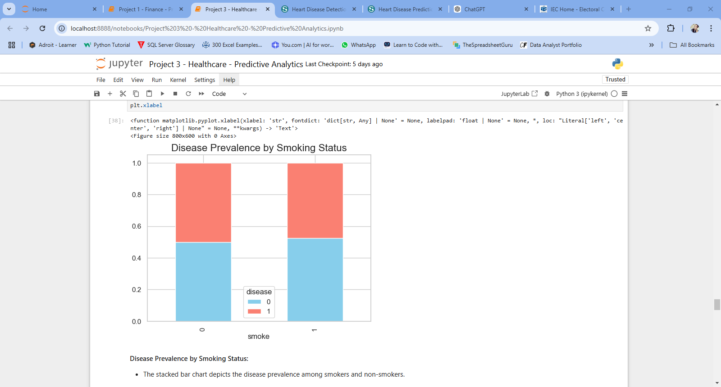
Key Comparisons
To better understand the factors contributing to cardiovascular disease, I analyzed the prevalence of the condition across two key variables: cholesterol levels and smoking status.
Cholesterol levels have a stronger influence on disease prevalence compared to Smoking Status.
Smoking shows a milder association with disease prevalence, potentially amplifying risk when combined with other factors like high cholesterol.
9

Slide 10
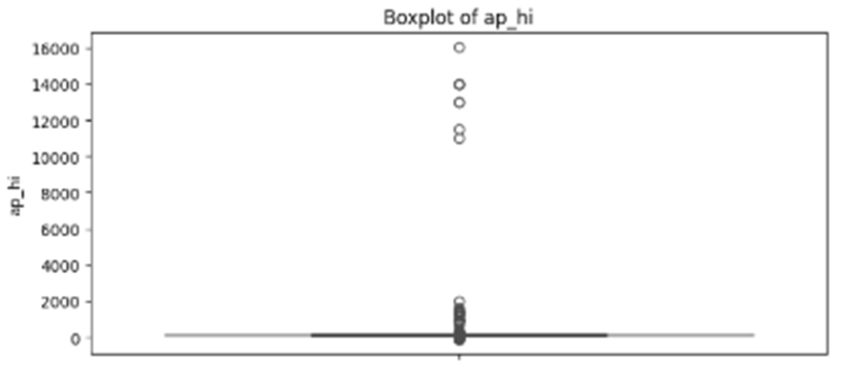
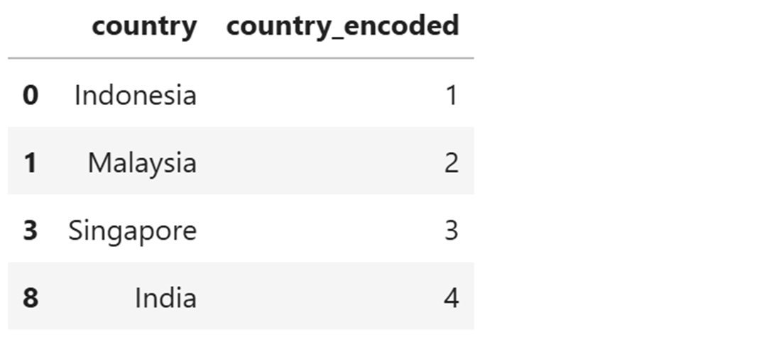
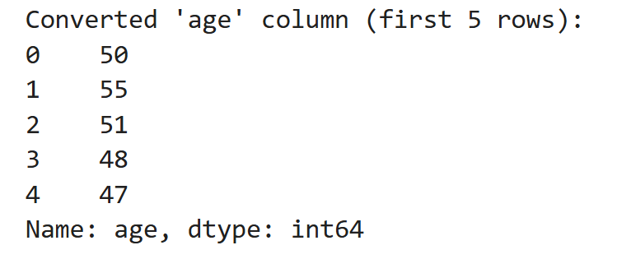
Data Preprocessing for Predictive Modeling
Before building our predictive model, it was essential to preprocess the data. This step ensured that the dataset was clean, consistent, and ready for analysis. Let’s discuss the key challenges encountered and the steps taken to address them.
Anomalies in numeric columns e.g. ap_hi, height
Categorical columns
Categorical variables were encoded using one-hot or label encoding.
Capping extreme values in numeric columns
Inconsistent data - Age column
Convert age from days to years
10

Slide 11

02.
Predictive Modeling
We will be testing and analyzing the predictive accuracy of 4 machine learning models.
11

Slide 12
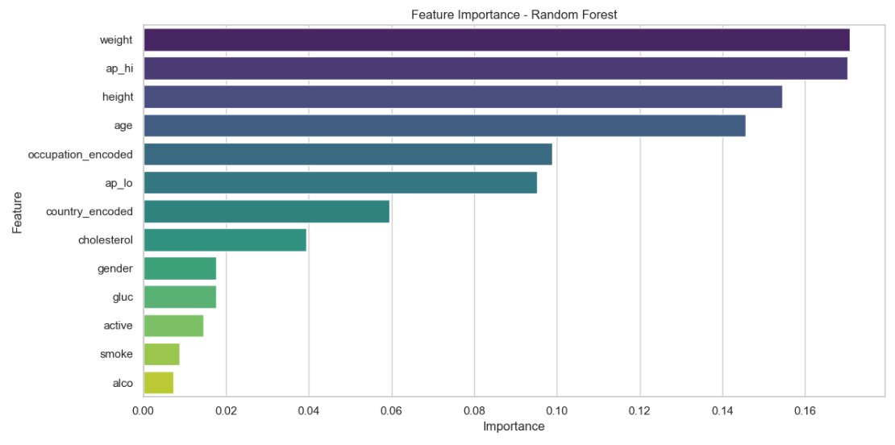
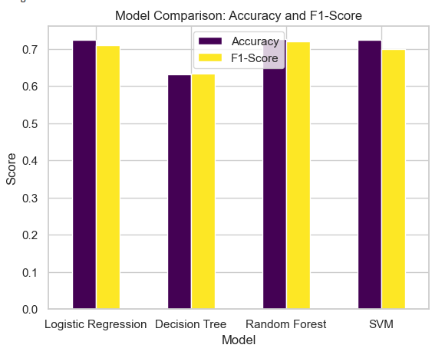
MODEL COMPARISON
CLASSIFIER MODELS
Accuracy and F1-Score: The models seem to have relatively similar performance in terms of accuracy and F1-Score.
The Random Forest model performs slightly better than the others in terms of both Accuracy and F1-Score.
FEATURE IMPORTANCE
This bar chart ranks the importance of various features used in the Random Forest model.
Weight and ap_hi are the most important features, followed by height, age, and occupation_encoded.
Features such as gender, gluc, active, smoke, and alco have lower importance compared to others.
12

Slide 13

03.
Conclusion
Key insights and recommendations
13

Slide 14
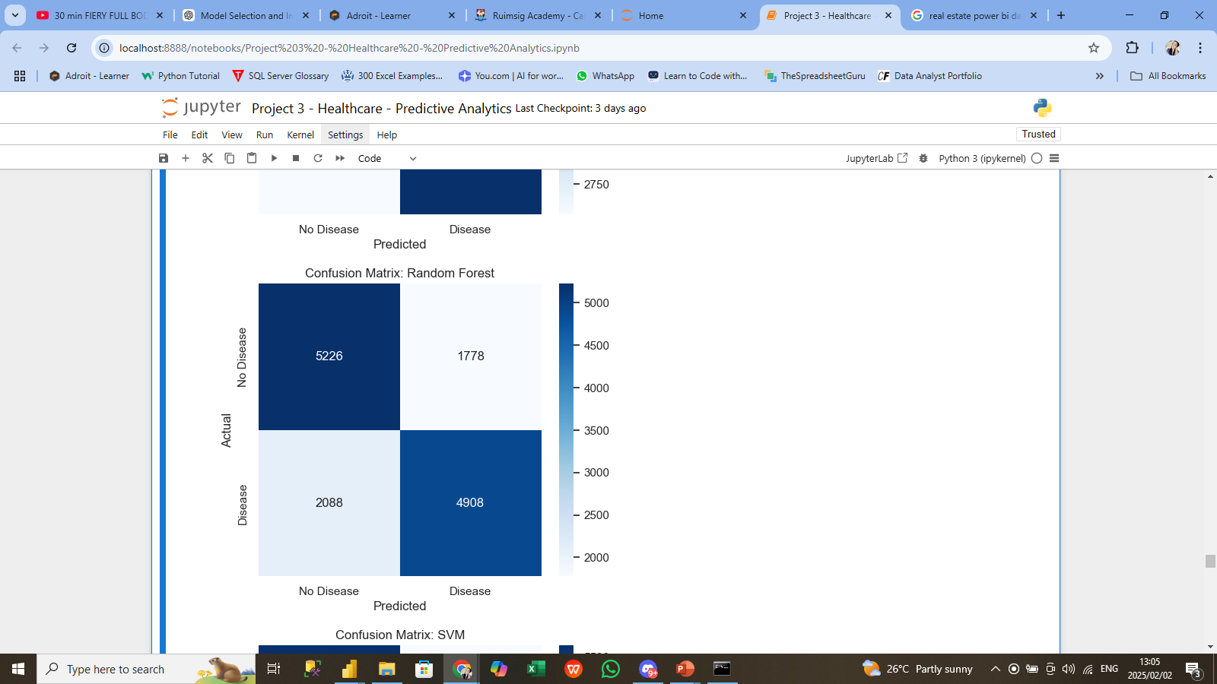
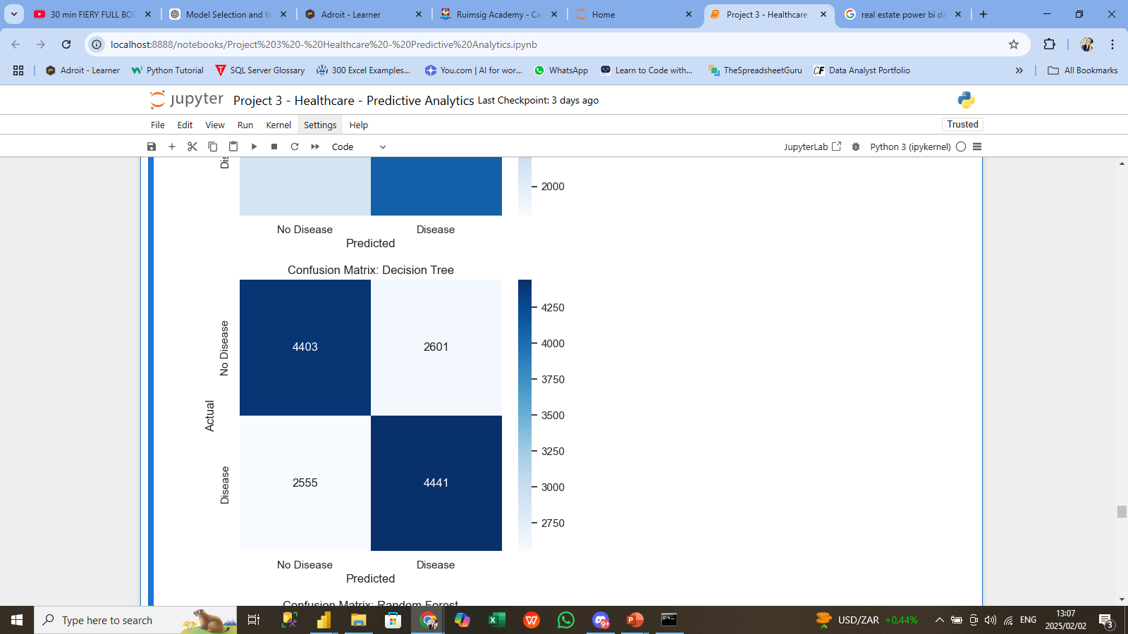
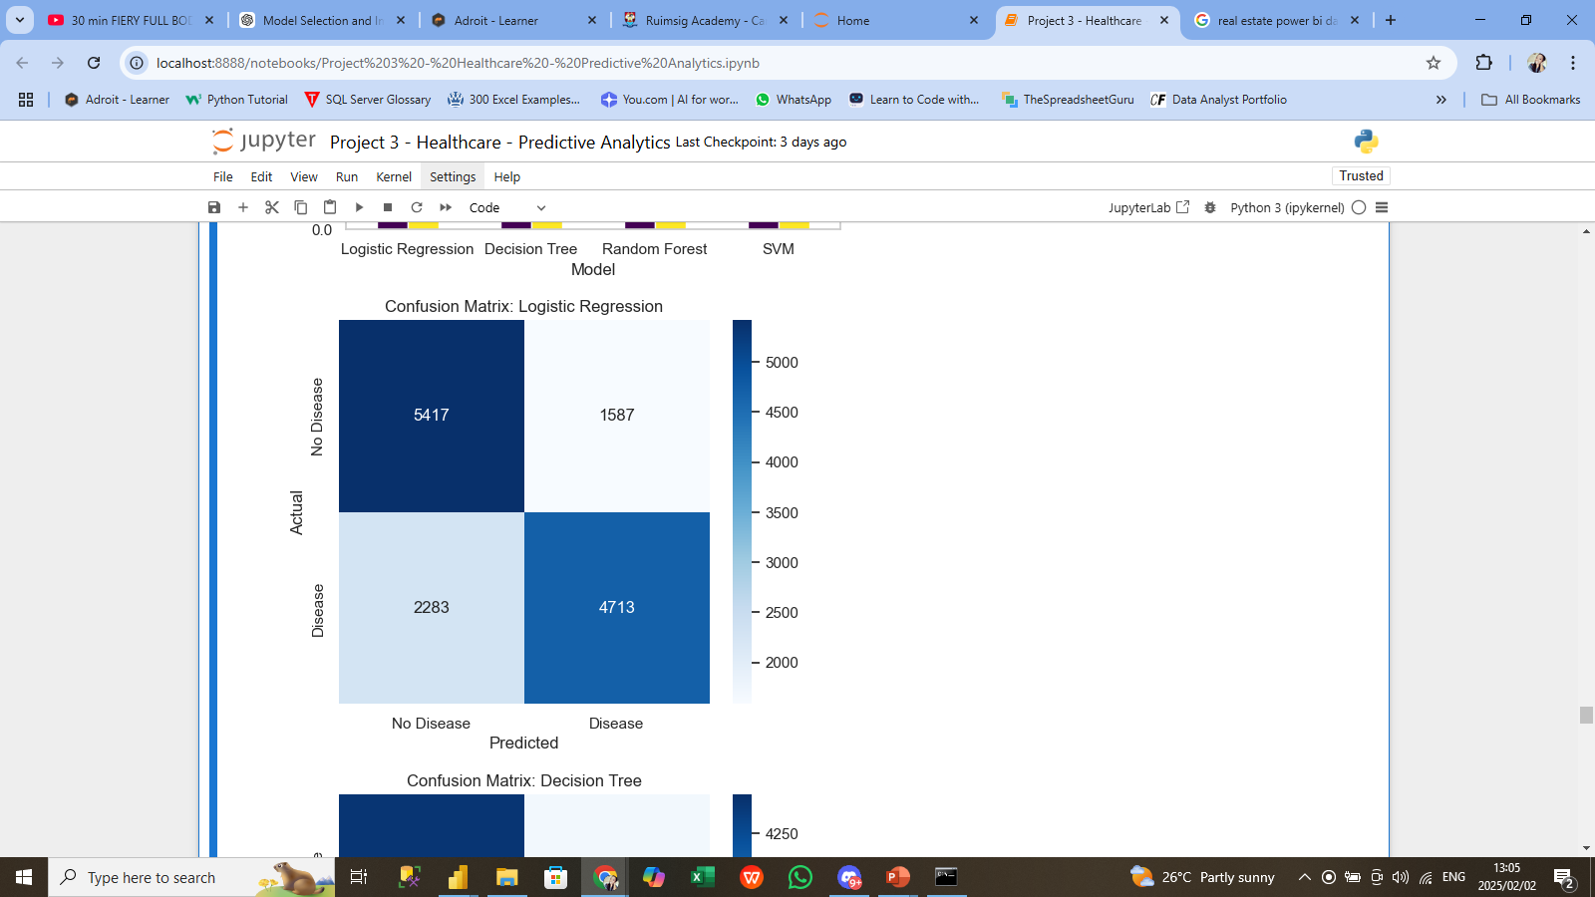
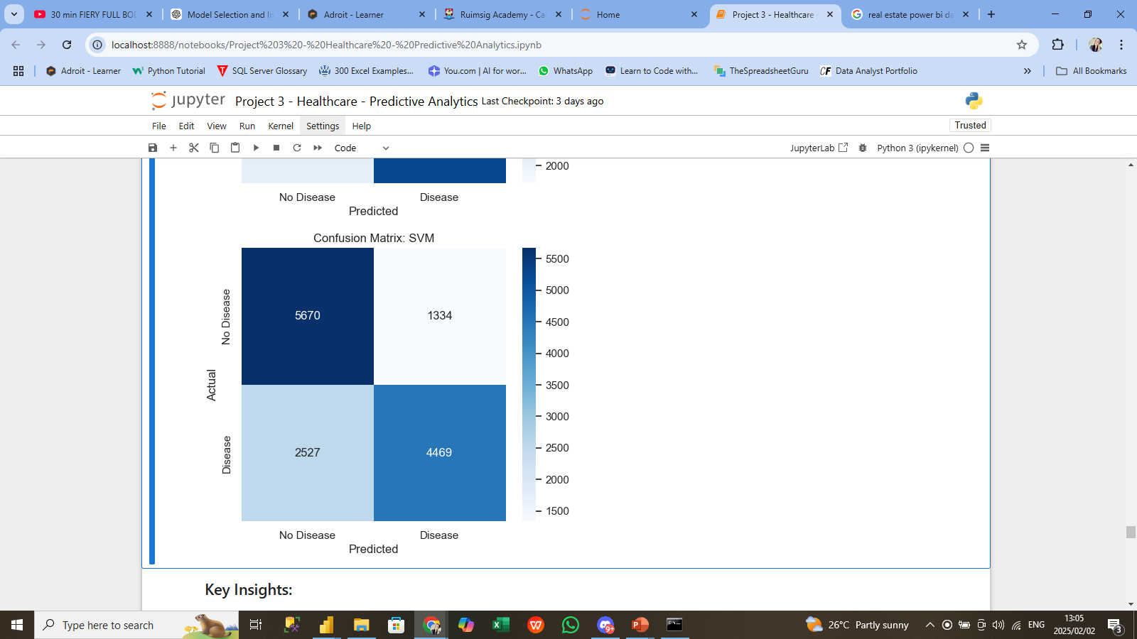
Key Insights
Model Performance:
SVM outperforms Logistic Regression, Random Forest, and Decision Tree in both accuracy and F1-score.
Insights from Confusion Matrices:
High true negatives and false positives observed across models.
SVM and Random Forest have a more balanced prediction performance.
14

Slide 15

Recommendations
Model Selection:
SVM is recommended for high accuracy and balanced performance.
Random Forest is a good secondary option.
Recommendations for Improvement:
Hyperparameter Tuning: Optimize models using grid search/random search.
Data Preprocessing: Address class imbalance and scale features.
Ensemble Models: Stack Random Forest and SVM for better results.
Cross-Validation: Apply cross-validation for more reliable model estimates.
Clustering models: Apply a clustering algorithm like K-Means to group the data into clusters based on the features.
15

Slide 16
Thank you!
16

